Slide 1
The Environmental Impact Of Software
Christian Abegg
Notes:
Christian
Jumped in for …
Who is … unfortunately
Happy to be back in Winterthur
Studied here
AND Met my employer
Software Engineer
Love job
Useful
Progress humand kind
No really, fantastic
Learn new stuff all the time – like here
Play around with the latest gadgets!
BUT

Slide 2
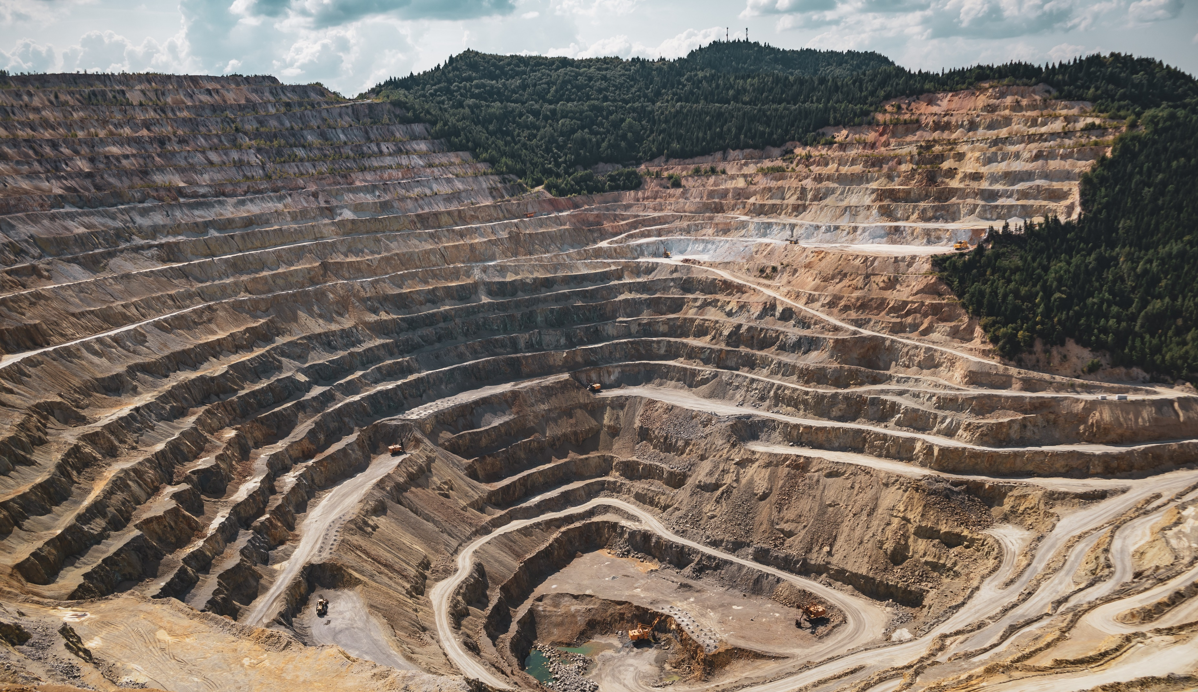
EXTRACTING RESOURCES
Pic: Vlad Chețan
Notes:
We are all responsible …
The biggest machines humans built do this work
You see, there’s a of effort needed
For example gold:
This ring caused about 20 tons of mine waste – consisting of rocks and toxic heavy metals
Ring is comparably light to a laptop
This laptop – 2kg - required 800kg of resources
All in all, the extraction work leads
to water, soil and air pollution
Source 20tons: https://earthworks.org/assets/uploads/archive/files/publications/20TonsMemo_FINAL.pdf
https://www.pexels.com/photo/mining-excavation-on-a-mountain-2892618/

Slide 3

FRESHWATER USAGE
Pic: Jill Burrow
Notes:
Water polution, because the extraction of resources requires a lot of water.
But also manufacturing
And cooling down the hardware we use
Requires a massive amout of water
To come back to the laptop: that required 190’000 liters of water to manufacture –
Or in other words: 100 liters per usage day when the device is used during 5 years
In addition to water, air and soil poultion, there is a second problem to resource extraction
: the so called easter egg problem.
The resources out there are not unlimited,
and the less that is in the earth, the more effort we have to put into excavating them.
And on the long term, a “chip shortage” like we had it after the pandemic is only a pretaste what we are facing when we run out of resources.
https://gerrymcgovern.com/water-mad-digital-devices/#:~:text=It%20takes%2014%2C000%20liters%20of,material%20for%20an%20average%20car.
https://www.pexels.com/photo/rippling-water-surface-of-swimming-pool-6858676/

Slide 4
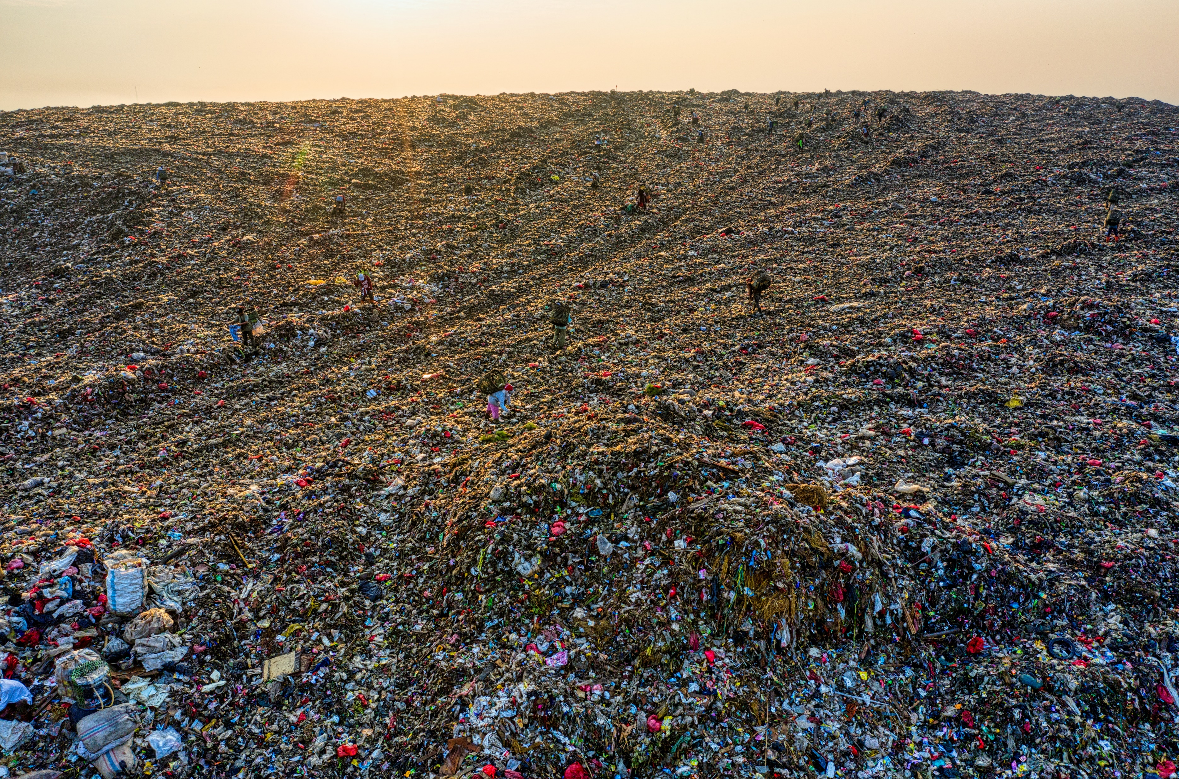
RECYCLING
Pic: Tom Fisk
Notes:
But hey, we are recycling, aren’t we? Sorry to disappoint you – but we are not.
Worldwide, only 17% of e-waste is collected
And only a small percentage of that is actually recycled – the remaining part is burnt or ends up in a landfills.
Why only so few? The problem with recycling electronic components is, that its technically very
challenging to separate the different materials.
In addition, the recycled materials end up having a lower quality.
https://www.pexels.com/photo/aerial-footage-of-landfill-during-dawn-5424851/

Slide 5
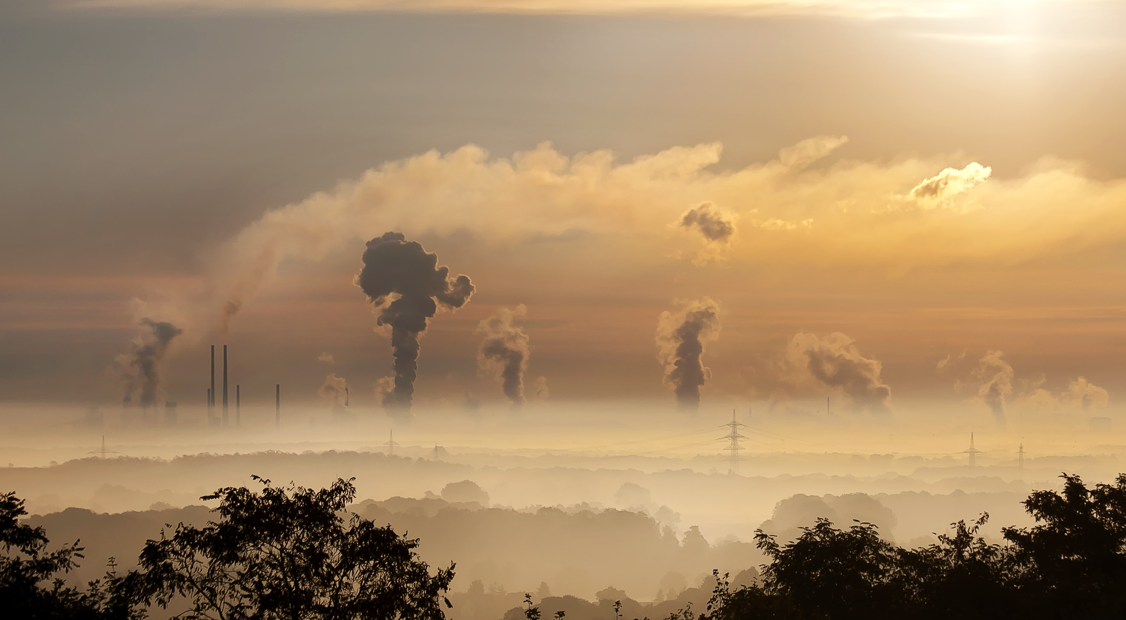
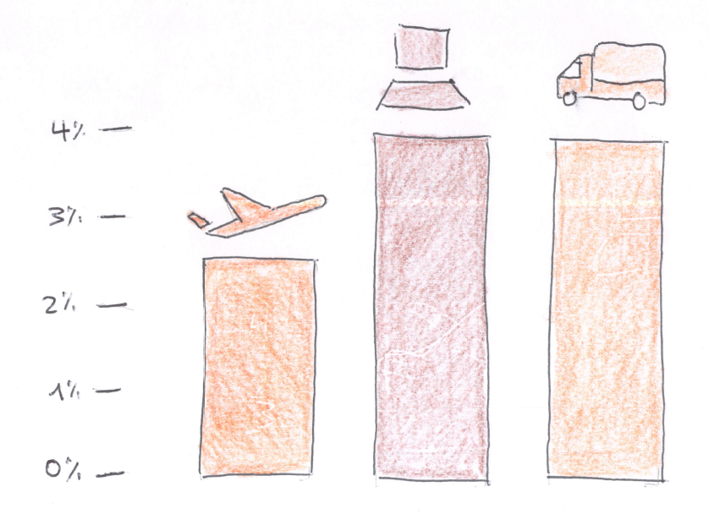
GREENHOUSE GAS EMISSIONS
Source: Digital Collage
Notes:
Let’s jump to another negative point: the greenhouse gas emissions.
Greenhouse gas is emitted for the production of the electricity we use to operate our hardware
and during the manufacturing
The digital sector is responsible…

Slide 6
GREENHOUSE GAS EMISSIONS
Notes:
Dirty industry
How to reduce the impact – specifically regarding the greenhouse gase emissions?
Lots of measures
Order of magnitude
Do math myself
https://www.pexels.com/photo/sky-clouds-building-industry-39553/

Slide 7
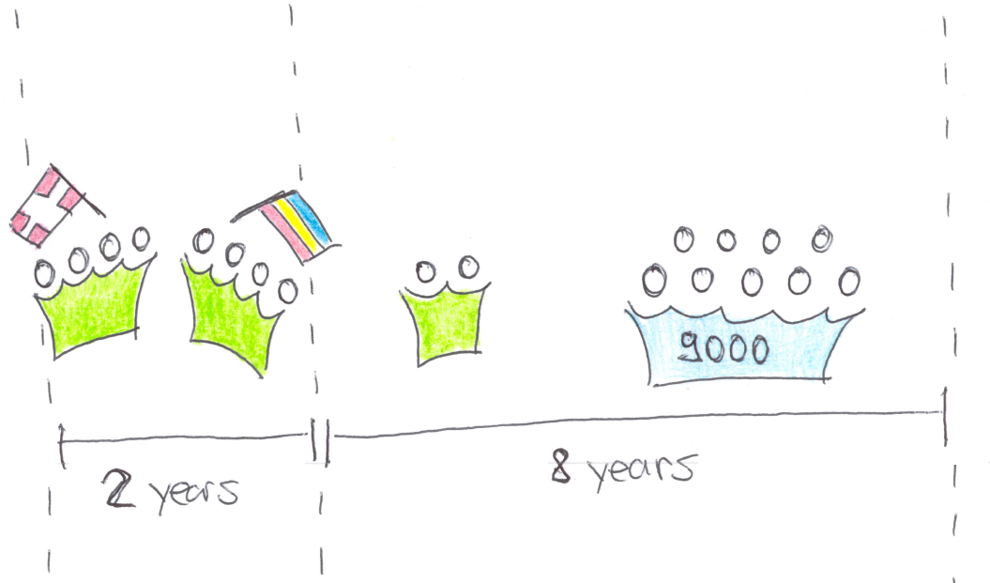
SIMULATED PROJECT

Slide 8
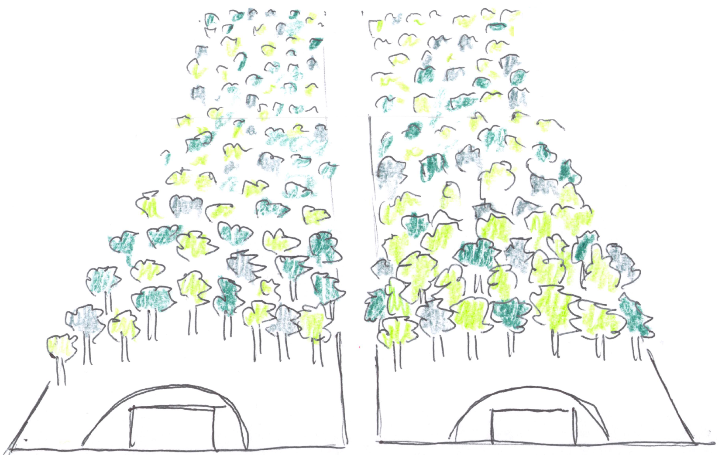
GREENHOUSE GAS EMISSIONS
Notes:
100t
In the area we can influence directly
300 000 fire extinguishers
2 footbal fields, during 10 years
https://www.pexels.com/photo/sky-clouds-building-industry-39553/

Slide 9
Total emissions
Engineers
Servers
Network Traffic
Notes:
Engineers: 65%
DevBoxes, Screens
Travel
Commute
Eat
Servers: 31%
Production, Staging, Test
CI/CD solution
Network Traffic 4%
- To end users
Let’s reduce these emission
ordered by their impact in the simulated software

Slide 10
Work in the same country
25%
Notes:
Avoiding flights

Slide 11
CUtting the number of cores and the memory in half
15%
25%
Notes:
VM
Case for optimized programming
Or to avoid overprovisioning

Slide 12
increase power usage EFFICIENCY by moving to a HYPERSCALER + lower emission factor per kwh
8%
Notes:
PUE from 2 to 1.1
Greener energy products

Slide 13
Switch off unused resources (i.e. outside of business hours)
8%

Slide 14
Decomission the 30% of zombie resources
7%

Slide 15
USE CLOUD BASED CI/CD solution
7%

Slide 16
USE A GREEN ENERGY PRODUCT
7%
Notes:
ProNatur: 19g/kwH
CH consumption: 153g/kwh
Easter Europe: 500g/kwh

Slide 17
INCREASE HOME OFFICE FROM 1 TO 3 DAYS
7%
Notes:
Avoiding commute
Other measures with the same angle
Means of transport

Slide 18
Eat Vegetarian lunches
6%

Slide 19
EXTENDING HARDWARE LIFESPAN BY ONE YEAR
5%
Notes:
Gain comes from embodied emissions

Slide 20
Relaxing hot-standby requirements - use IaC
4%

Slide 21
REDUCING network TRAFFIC BY 25%
3%
Notes:
Not a traffic intensive application
Don’t apply it to your scenario 1:1
And another warning: it’s not scientific!

Slide 22
Combined measures
75% reduced
25%
Notes:
Cannot just add together
Saved 75tons!

Slide 23
Combined effort
25%

Slide 24
github.com/abeggchr/ environmental-impact-estimator
Notes:
You find all the calculations in my github repo
And I look forward to exchange on it
So, to close:
Let us reduce the environmental impact …

